Slide 1


Fall 2018
Applied engineering Data analysis, optimization and visualization
Getting started with TACC
Joshua Rhodes, PhD
Research Fellow/Adjunct Professor, The University of Texas at Austin

Slide 2
TACC is the Texas Advanced Computing Center
Started in 1960s with a CRAY CDC 6600
Your phone is more powerful than this thing now
TACC became TACC in 2001
Mostly housed at the PRC campus
Visualization lab on Main Campus

Slide 3
TACC is available for you as part of UT
Computing is free
Your advisor needs to get a project set up
TACC can be brought on for research projects and as computing support for grants
Deeper dives into using TACC, by TACC
https://learn.tacc.utexas.edu/

Slide 4
Logging into TACC
From Terminal
ssh <username>@maverick.tacc.utexas.edu
Password
2-factor authentication

Slide 5
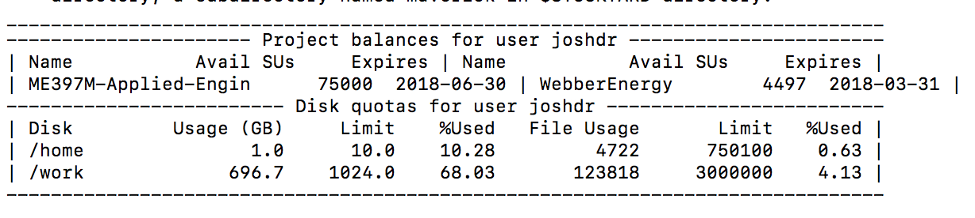
The first thing you see is your account balance

Slide 6
$Home vs. $Work directory
$Home: where you run programs from
10GB storage
$Work: where you store your data
1TB storage
You can access your data in work from home
i.e. function running in $home can read file in $work

Slide 7
You land on your home folder
home/XXXXX/<tacc_username>
The same commands we learned in Lecture 2:Terminal apply here
cd, mkdir, ls, rm, rmdir, etc.

Slide 8
When you first log on, you are on a login node
YOU CANNOT RUN PROGRAMS ON THE LOGIN NODE – YOU WILL GET KICKED OFF
You can make folders, move files, edit file, install programs, queue files to run

Slide 9
There is a way to get a compute node all to yourself
You can create an interactive development session
idev –m 90
-m 90 = get computer for 90 min, default = 30 min
Will kick you off and not save anything at end of time!!

Slide 10
So now that I am in, what do I do?
You have to load programs (modules) before you can use them
Like double-clicking on an icon
To check what you can run
module avail

Slide 11
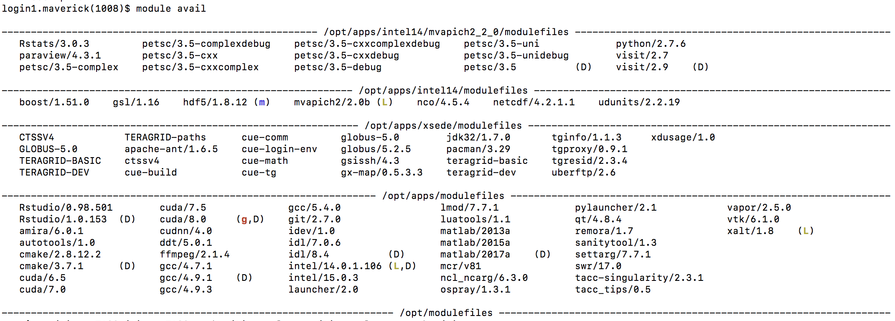
What modules are available?: module avail

Slide 12
Is that it?
Check for ALL installed programs
module spider
Check for installed programs that start with R
module spider R
>

Slide 13
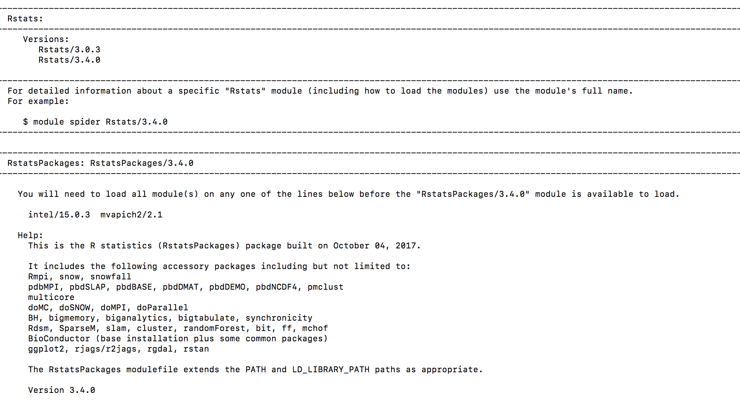
We have multiple versions of R installed and available, v3.4.0 has dependencies (so it d/n show up earlier)

Slide 14
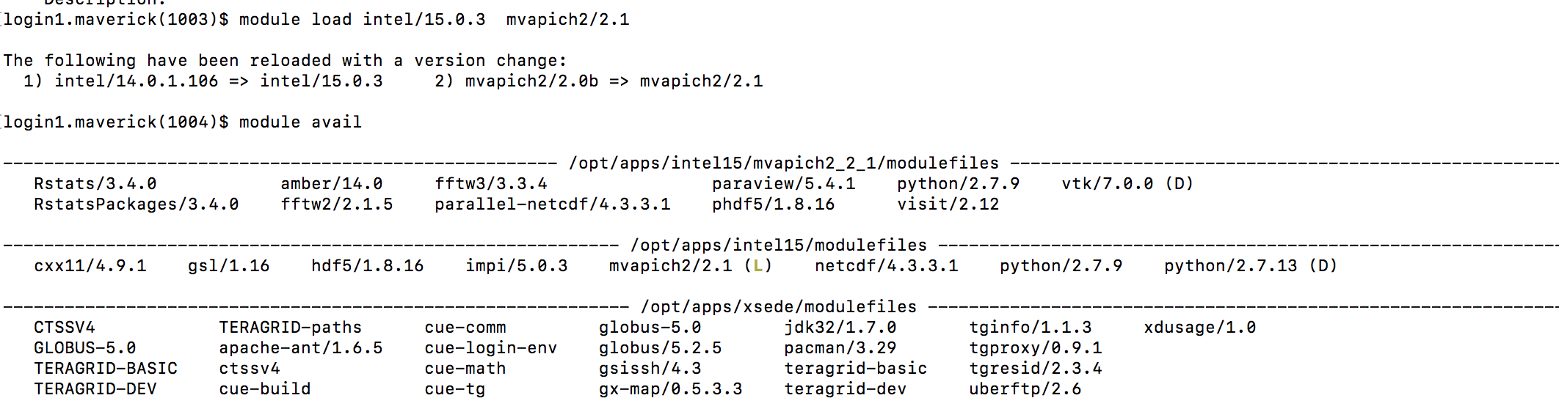
For the packages we used to build our R homework, we need R v3.4.0
We must load the dependencies first

Slide 15
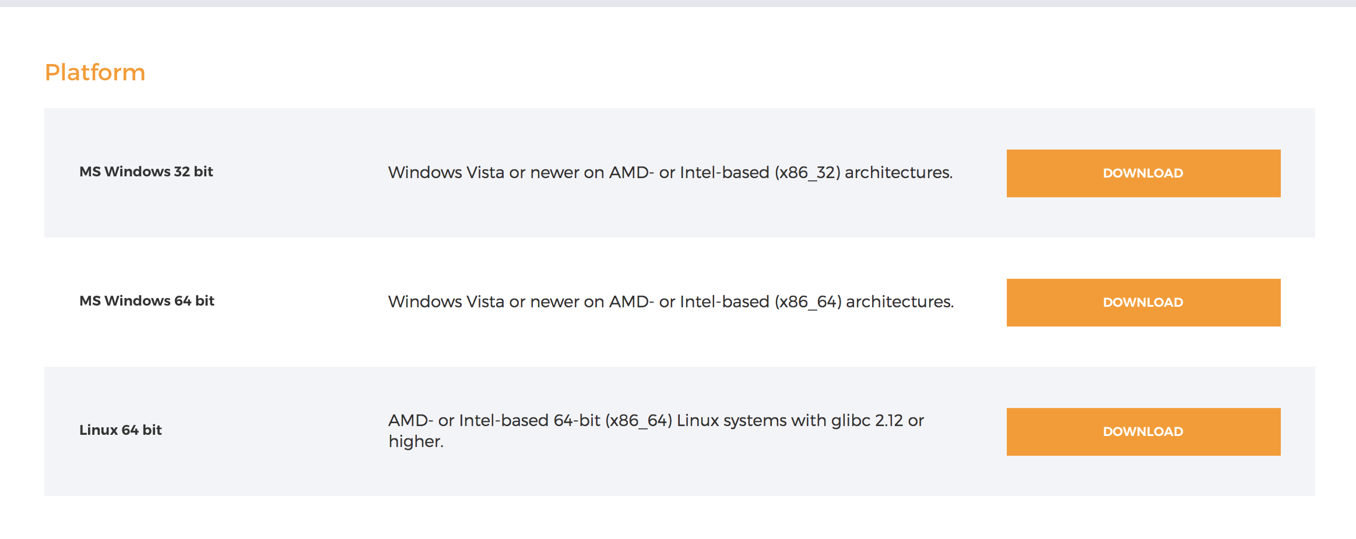
Installing your own software
Here we will install GAMS
https://www.gams.com/24.8/docs/userguides/userguide/_u_g__u_n_i_x__i_n_s_t_a_l_l.html

Slide 16
You can create shortcuts for yourself
alias gams=~/opt/gams/gams25.0_linux_x64_64_sfx/gams
alias gamslib=~/opt/gams/gams25.0_linux_x64_64_sfx/gamslib

Slide 17
To use TACC for more than 90 minutes, you will need to submit a job to the queue
There is a sequence to get in the queue
Shell script
R script

Slide 18
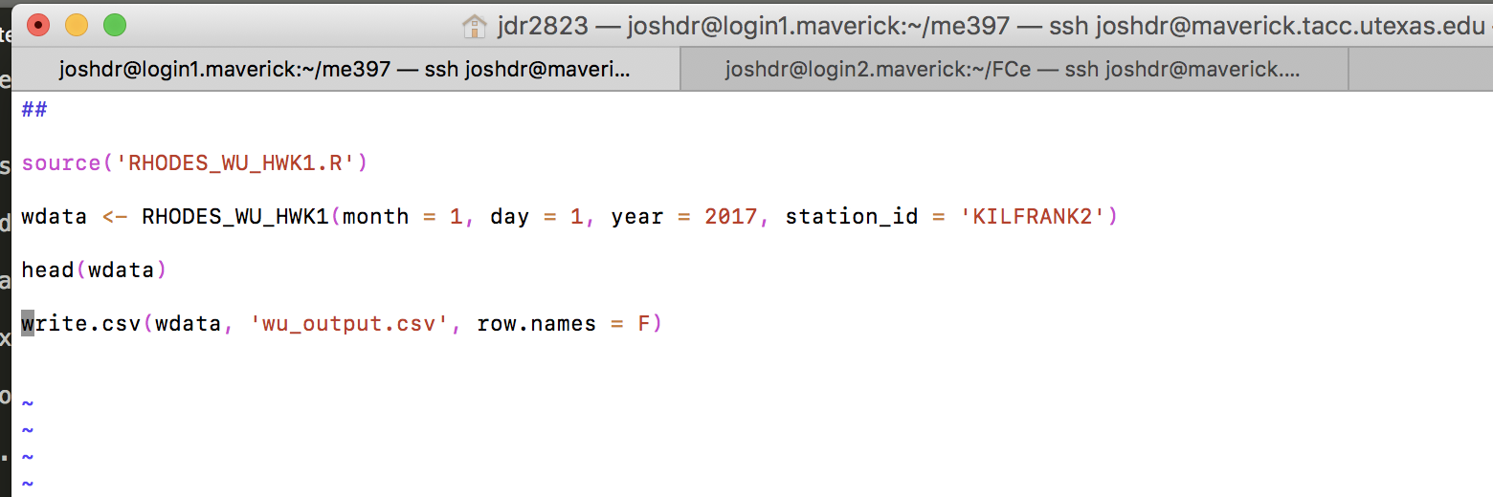
Aside: you can use VIM to make some quick edits

Slide 19
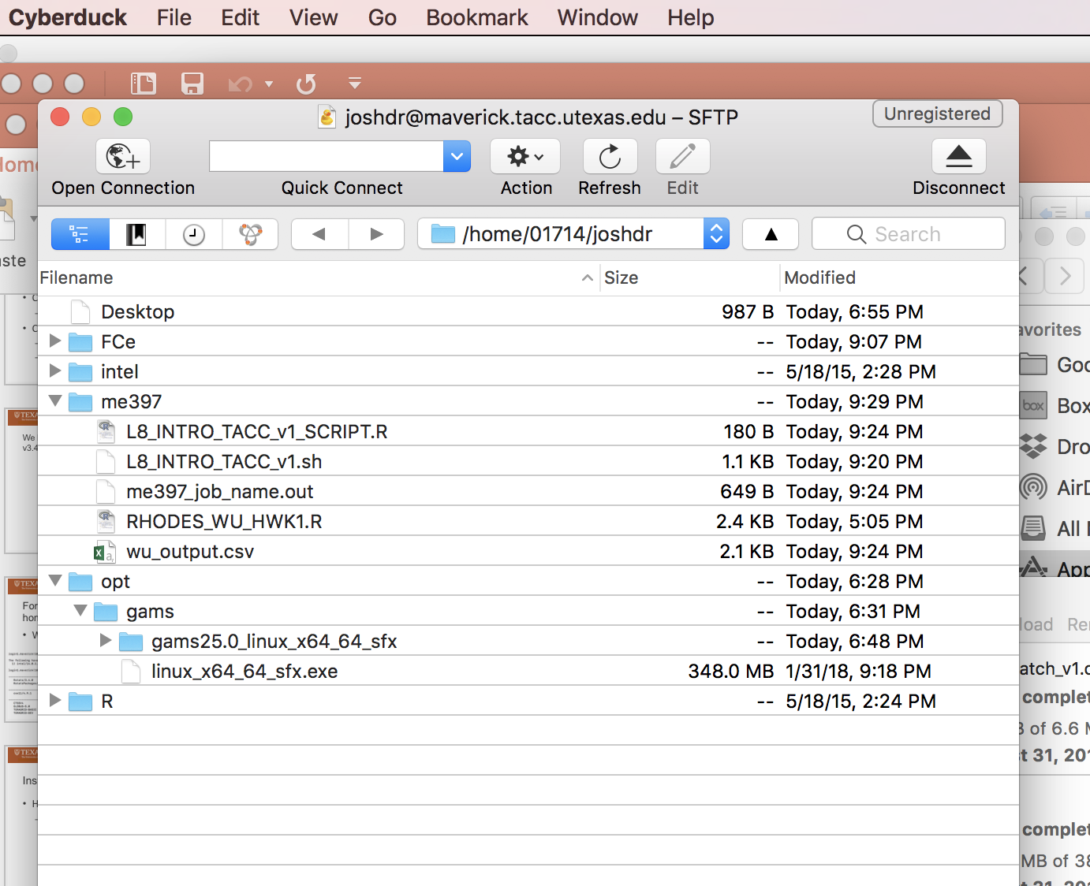
You can use a utility like CyberDuck to make life easier

